Slide 1


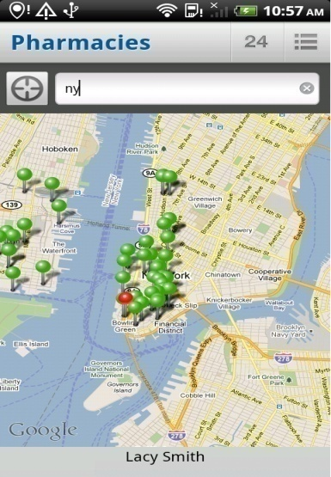
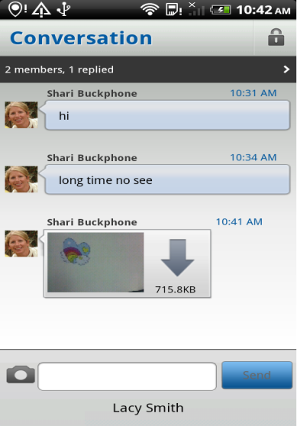
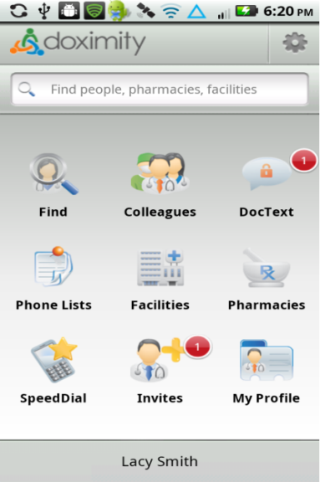


KTAF – MARCH, 2011
Nguyen Tien Chien
FDM.DMU
Android Development
Duration: 2:00 hours
DoximityDroid
Knowledge Sharing
Notes:
=>Objectives

Slide 2
Objectives
1. Select Vendor and Contract Agreement
2. Android Development Proposal
3. Sub-Contractor Management
4. Onsite Candidate Interview
5. Negotiation
6. Android Technical Stuffs
7. Publishing an Android app to Android Market
Notes:
=>Case Study

Slide 3




Case Study
Porting
Requirement
Time to market: 12 weeks
Design
UAT Support
Scope of
work
Implementation
Test
Notes:
. Time to market: 12 weeks
. Scope of work (3 Android devices – Samsung Galaxy S, HTC Nexus One and Motorola DROID 2)
=> Inputs from Doximity

Slide 4
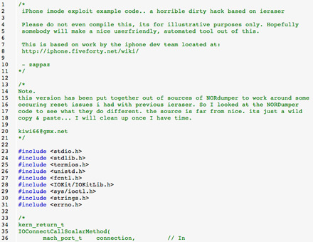
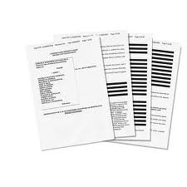
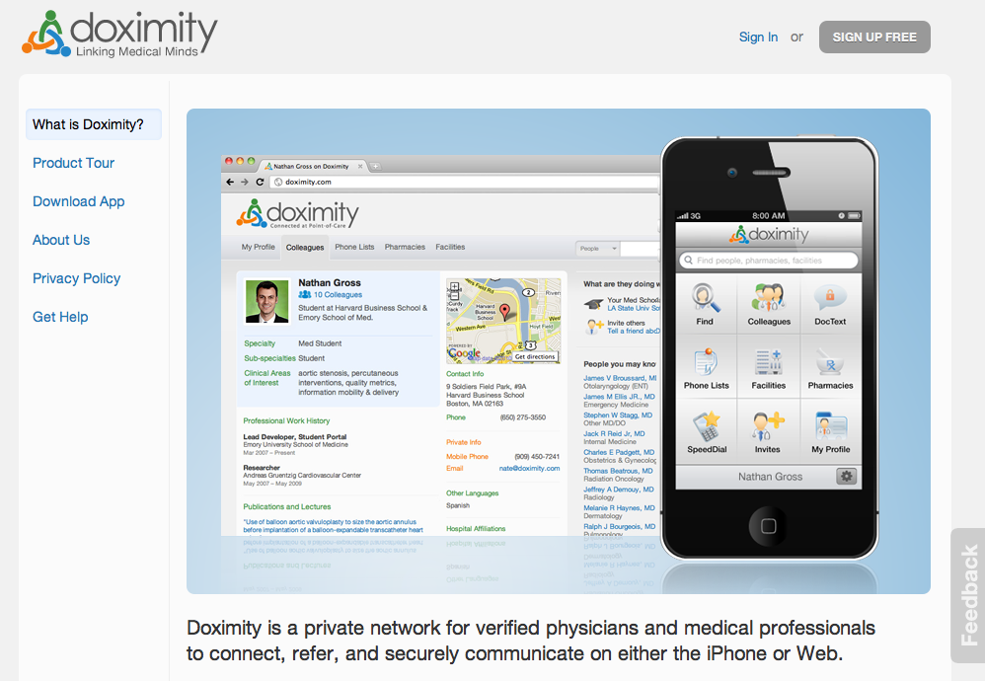
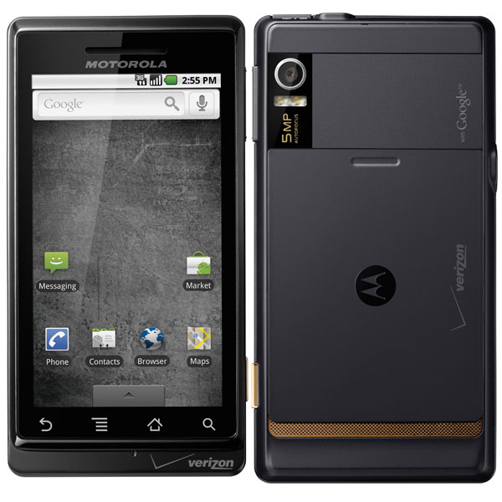
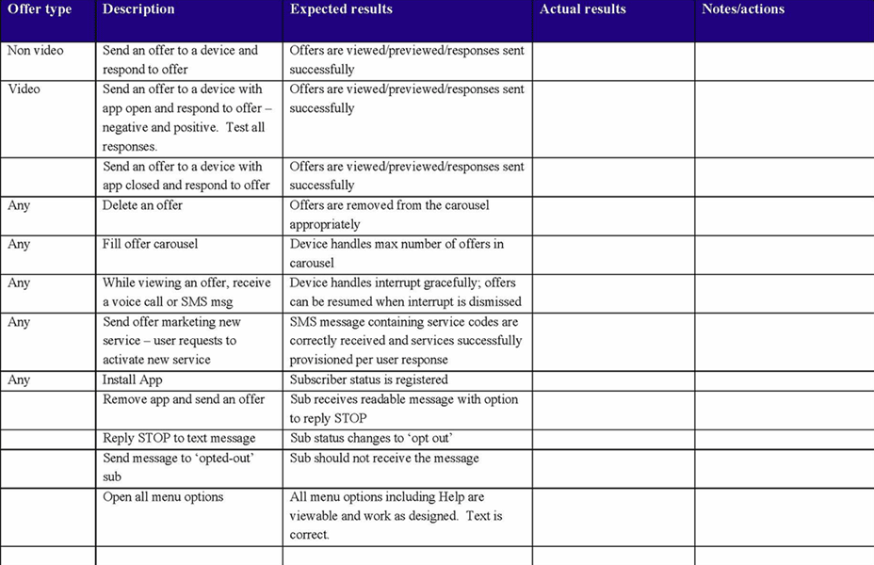
Inputs from Doximity?
WebServices API docs
Test Case docs
Notes:
. iPhone sourcecode
. Website
. WebServices API docs (pure)
. Test Case documents
. Motorola DROID 2
=> Resources Needed?

Slide 5

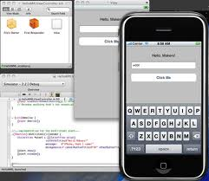

Resources Needed?
iPhone dev skill
Android dev skill
Notes:
. People
. iPhone development skill
. Android Development skill
No iPhone/Android development
=> What need to do?

Slide 6


Whats need to do?
Outsourcing....Why?
Notes:
. Outsourcing and Why?
. No people with required skillsets
. Money, 12% billable
=>Risk?

Slide 7




Outsourcing
Notes:
. Communication
. Quality Control
. Deadline
=> First Steps for Outsourcing?

Slide 8


First steps for outsourcing?
VISULIZE ACTIVITIES WITH TIMELINES!
NDA
Select Vendor
2005
2007
2011
2013
Notes:
. Select Vendor
. Contract with NDA
=> Lumos

Slide 9


Lumos Profile
Selected Vendor
Notes:
=> Select Vendor and Contract Agreement

Slide 10
1. Select Vendor and Contract Agreement
VISULIZE ACTIVITIES WITH TIMELINES!
NDA
Select Vendor
2005
2007
2011
2013
Notes:
. No DAR for Vendor
. Contract details
=> Android Development Proposal

Slide 11
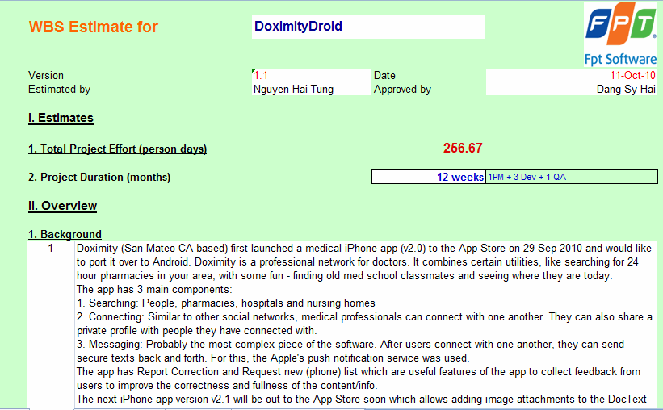
2. Android Development Proposal
Proposal
200%
Unit Testing –%?
3 days
Proposal + Prototypes
Complexity
Android hardwares and firmwars
Notes:
. 200% of coding effort
. Android proposal
=> Project Starts?

Slide 12

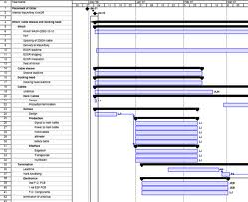
Project Start?
VISULIZE ACTIVITIES WITH TIMELINES!
2005
2007
2011
2013
Notes:
. Different locations
=> Communication Plans

Slide 13
Communication Plans
Fsoft – Doximity plan
Fsoft – Lumos plan
Notes:
=> Project Environment

Slide 14

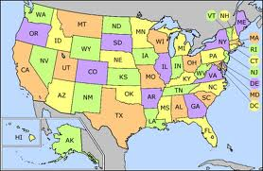
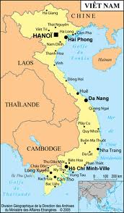




Project Environment
2 (PM, Designer, 2 Devs, 1 Test)
1 (Dev)
3 (Supervisor, PM, 1 QA)
2 (PM, Designer)
1 (Senior Dev)
1 (WebServices Dev)
Notes:
. San Mateo – CA, Sydney and Hanoi (Fsoft and Lumos))
. Any risky?
. Need a senior Android developer
=> Project Environment (Weekly call, etc)

Slide 15
Project Environment
Weekly Meeting
and Reporting
Daily call/mail
Weekly Conf call and Reporting
Daily call/mail
Weekly Conf call
Notes:
. Communication (call)
=> Miletones

Slide 16
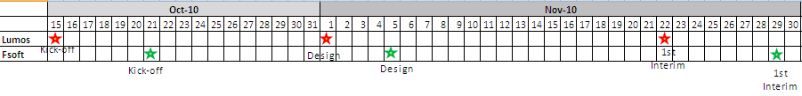
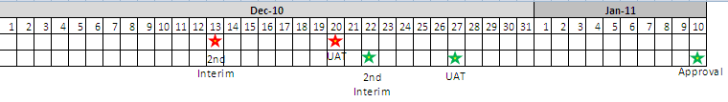
Milestones
Notes:
.Deviation of two plans
=> Source Code Control

Slide 17


Source Code Control
Daily commit
Development Team
Doximity & Onsite Coordinator
Delivery
FTP
iPhone code download
Notes:
=> Pivotal Tracker

Slide 18
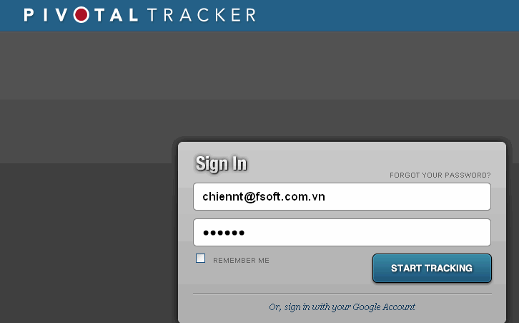
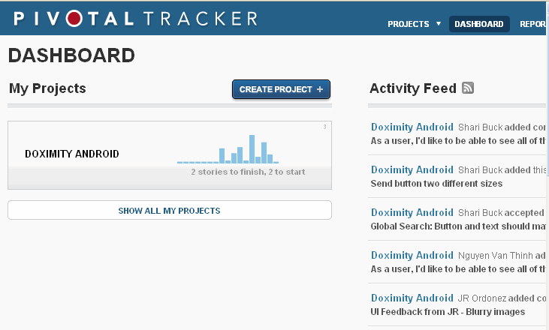
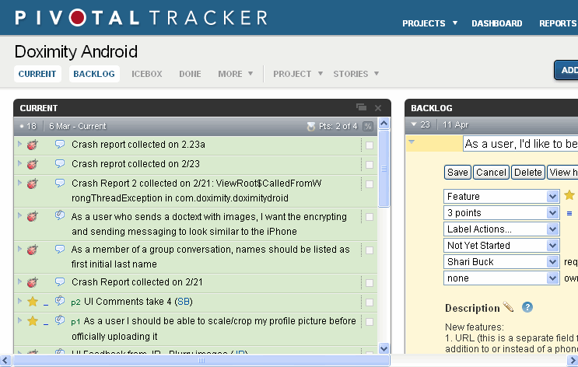
Q&A
https://www.pivotaltracker.com/signin
Notes:
=> Project Kick-off

Slide 19

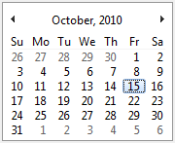
Project Kick-OFF
VISULIZE ACTIVITIES WITH TIMELINES!
2005
2007
2011
2013
Notes:
=> Project Execution (Localization)

Slide 20

Project Execution
Call
Chat
Meeting
Email
Notes:
=> Sub-contractor management

Slide 21
3. Sub-Contractor Management
Call
Chat
Meeting
Email
Notes:
. Unique project environment
=> Onsite Preparation

Slide 22



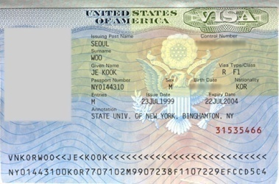
Onsite Preparation
Onsite
Candidate
Su26
FDN
Go onsite
Notes:
. Su26 onsiter => Failed VISA
. FDN onsiter => Pass VISA
=> Onsite Performance

Slide 23

Onsite Performance
Where?
Su26
FDN
Notes:
. Su26 to go onsite
. FDN to go back
=> Onsite Candidate Interview

Slide 24
4. Onsite Candidate Interview
Key point?
Motivation?
Notes:
. Key point?
. Motivation?
=> Resource Allocation

Slide 25

Resource Allocation
3 Java devs
2 (dev + test)
2 (dev + test)
2 (dev + test)
OSDC Lead
LinhDK
Notes:
=> Negotiation

Slide 26
5. Negotiation
Re-schedule 2 weeks
Change PM
LinhDK
Notes:
. Reschedule 2-weeks => Jan 10, 2011
=> Android Technical (Development Environment)

Slide 27



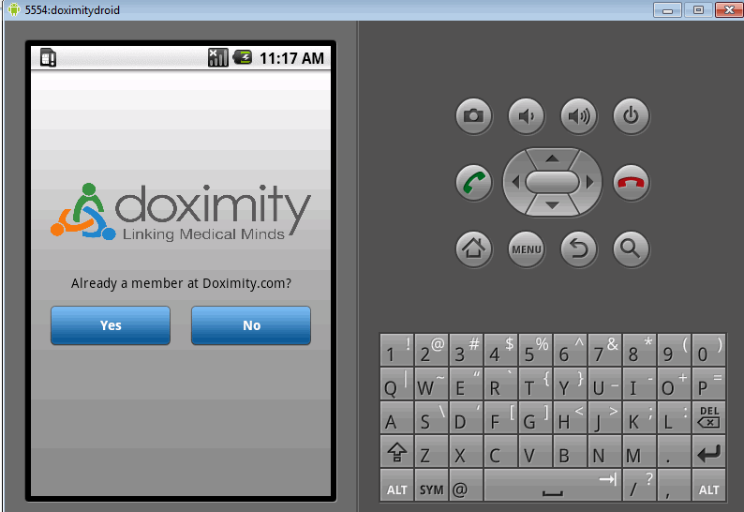
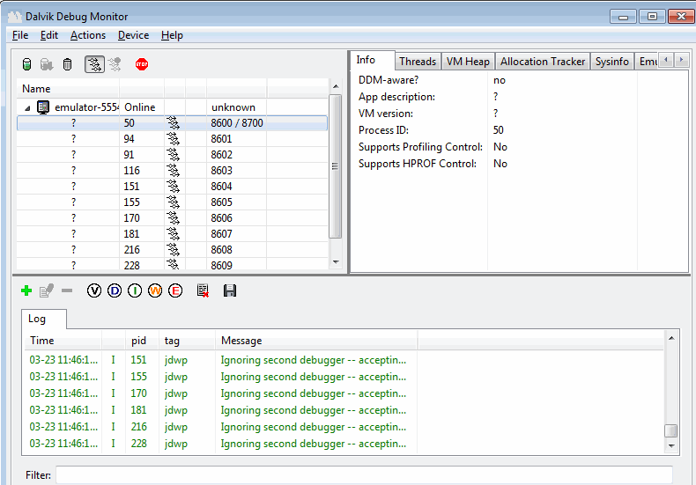
5. Android Technical
Development Environment
ADT Plugin (Android Development Tool
Emulator
(AVD)
DDMS
Notes:
=> Android Technical (Application Architecture)

Slide 28
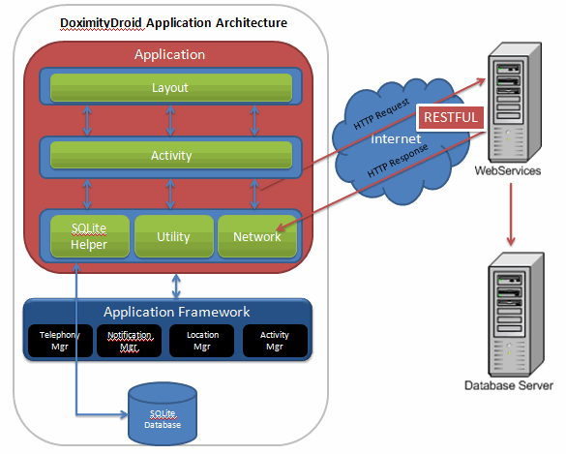
5. Android Technical
Application Architecture
XML
Notes:
=> Android Technical (HTTP Request and Response)

Slide 29
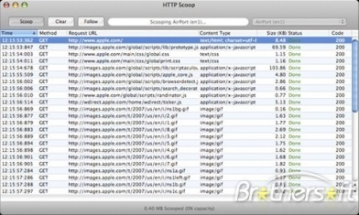
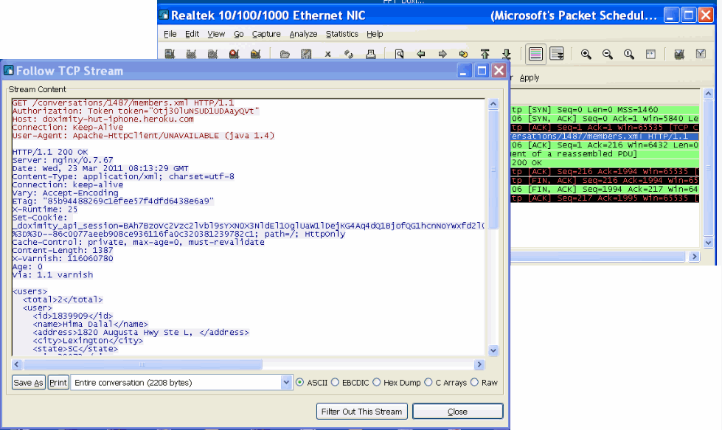
5. Android Technical
HTTP Request and Response Debuggers
WebServices Request/Response
HTTP Scoop
WebServices Request/Response
Wireshark
Notes:
=> Android Technical (Recommended Testing Devices)

Slide 30
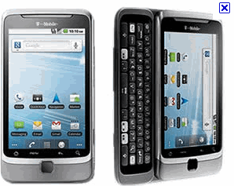
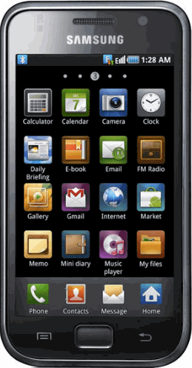
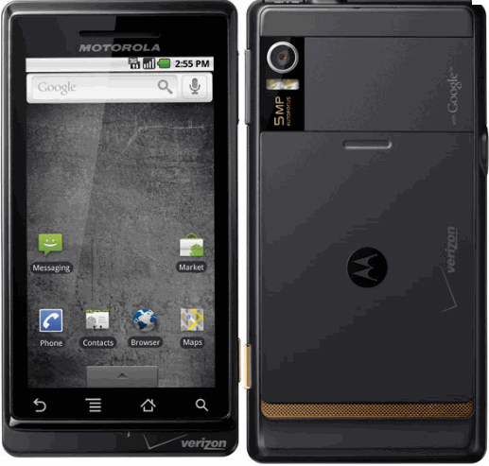
S
5. Android Technical
Recommended Android Devices for Testing
Hard keyboard
Unit Testing effort
200% of Coding?
HTC Desire Z
Samsung Galaxy S
Motorola DROID 2
Notes:
. Unit Testing effort => 200% of coding?
=> Android Technical (Hudson Continuous Deployment Tool)

Slide 31
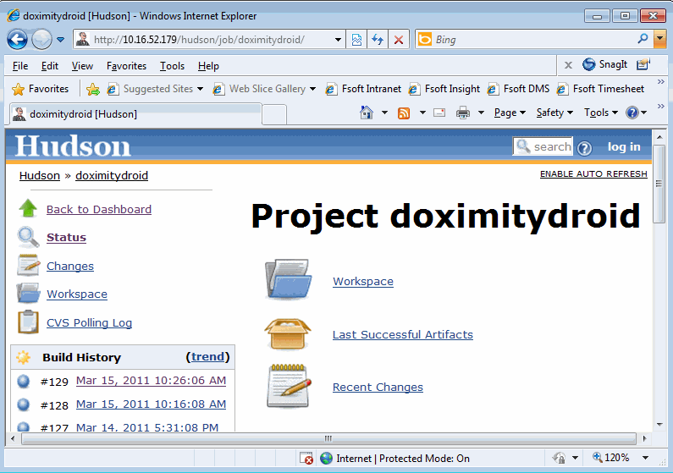
S
5. Android Technical
Hudson Continuous Deployment Tool
Notes:
=> Android Technical (Hudson Continuous Deployment Tool - Changes)

Slide 32
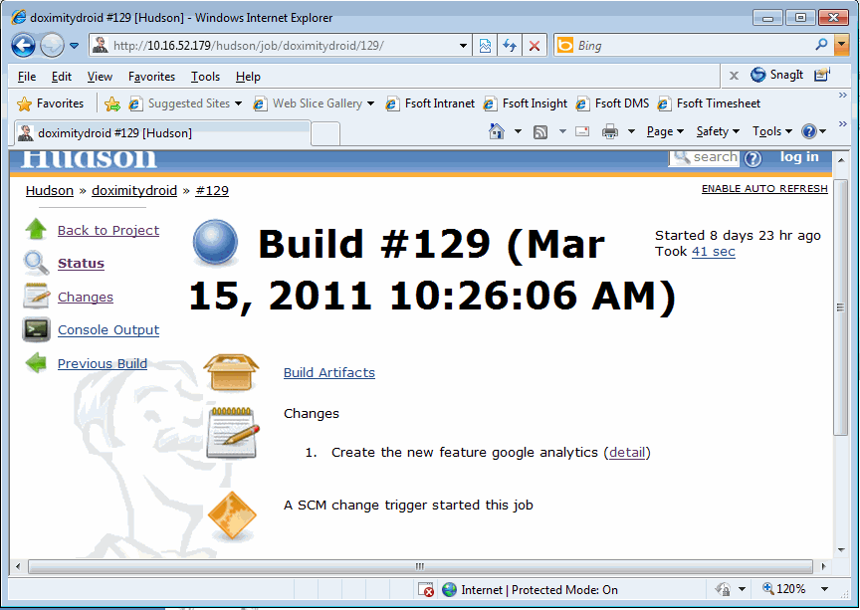
S
5. Android Technical
Hudson Continuous Deployment Tool
Notes:
=> Android Technical (Hudson Continuous Deployment Tool – Updated files with owner)

Slide 33
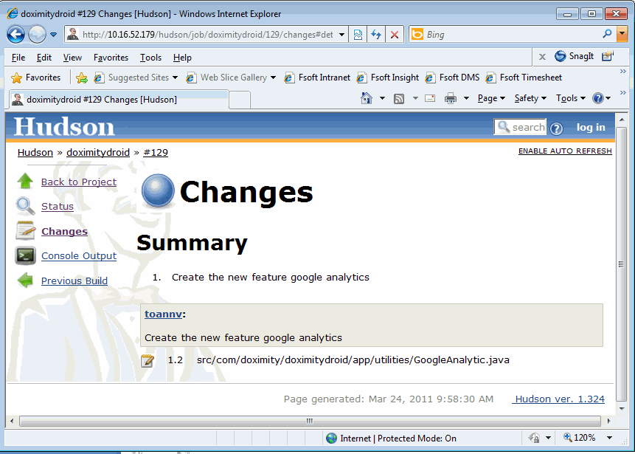
S
5. Android Technical
Hudson Continuous Deployment Tool
Notes:
=> Pencil- UI Mock-up screens Design Tool

Slide 34
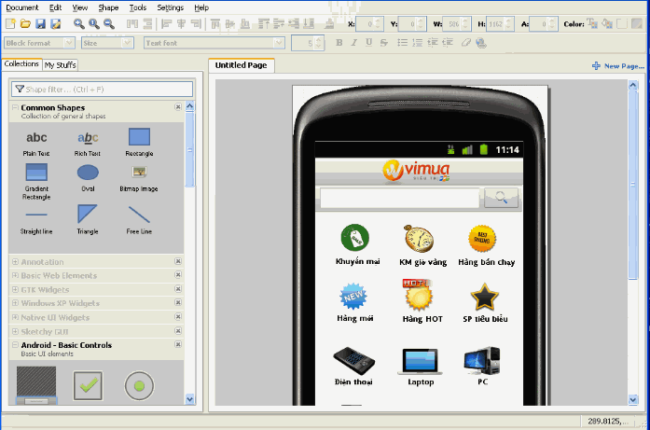
S
5. Android Technical
Pencil - UI Mock-up screens Design Tool
Notes:
=> Pencil- UI Mock-up screens Design Tool (Vimua Home screen)

Slide 35
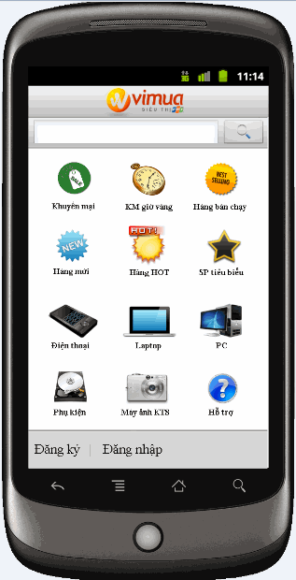
S
5. Android Technical
Pencil- UI Mock-up screens Design Tool
Notes:
=> Android Technical (Other technical stuffs - cont)

Slide 36

S
5. Android Technical
Other technical stuffs
Google Maps
(Show current Location and Display Map Pins) – zoom and pan
Intent Manager (Customize to control flows among activities)
Force Close (Samsung Galaxy S)
Capturing images
(Various Android hardwares)
Notification (inside or outside of the app)
Drag and Drop (SpeedDial list)
Crop and Scale Image (using Intent)
Zoom Image (one-finger zoom) – 1.6
Notes:
=> Android Technical (Other technical stuffs - cont)

Slide 37
S
5. Android Technical
Other technical stuffs
Soft keyboard (Show/Hide)
Android Setting (Inside app)
Hard keyboard
(Closing while app is running)
Showing images ( 480x800, 480x854 or 320*480)
SQLite Database (Insert batches)
Google Analytics
SQLite Database (read/write - locked)
Out of memory (Java Performance Tuning)
Send secure/unsecure messages (with or without images attached)
Notes:
=> Publishing Android app to Android Market

Slide 38
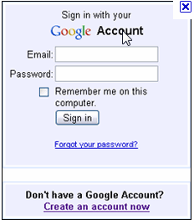
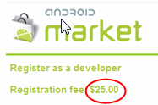

6. Publishing an Android app to Android Market
Prepare the APK
Step 1.
Step 2.
Step 3.
Notes:
=> Publishing Android app to Android Market => APK Preparation

Slide 39
5. Publishing an Android app to Android Market
Prepare the APK
Prepare the APK
Step 1.
Step 2.
Add EULA
icon and label
Step 3.
Turn off logging/debugging
Step 4.
Step 5.
Versioning
Step 6.
Sign and Align
Step 7.
Testing
Notes:
Android manifest.xml
=> DoximityDroid on Android Market

Slide 40
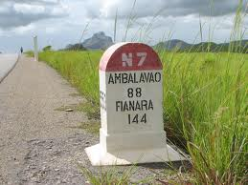



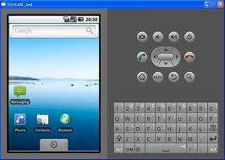

Lesson Learnt
and Practices
NDA
WebServices Request/Response
HTTP Scoop
Offshore
Onsiter
4-5 or 7-8 minutes
(https)
Notes:
=> Useful references for audiences

Slide 41
Useful References for audiences
Android Development guideline v1.0.doc
Professional Android Application Development 2009.pdf
Publishing to Android Market_guideline v1.1.doc
http://developer.android.com/guide/index.html
Tools
  Android USB Drivers for Samsung Galaxy S and Motorola DROID 2
  Pencil http://pencil.evolus.vn/en-US/Home.aspx http://code.google.com/p/android-ui-utils/
  Hudson
  Eclipse plugins
    Java Decompiler
    FireBugs
    Checkstyles
ChienNT@fsoft.com.vn
Notes:
=> Finish

Slide 42
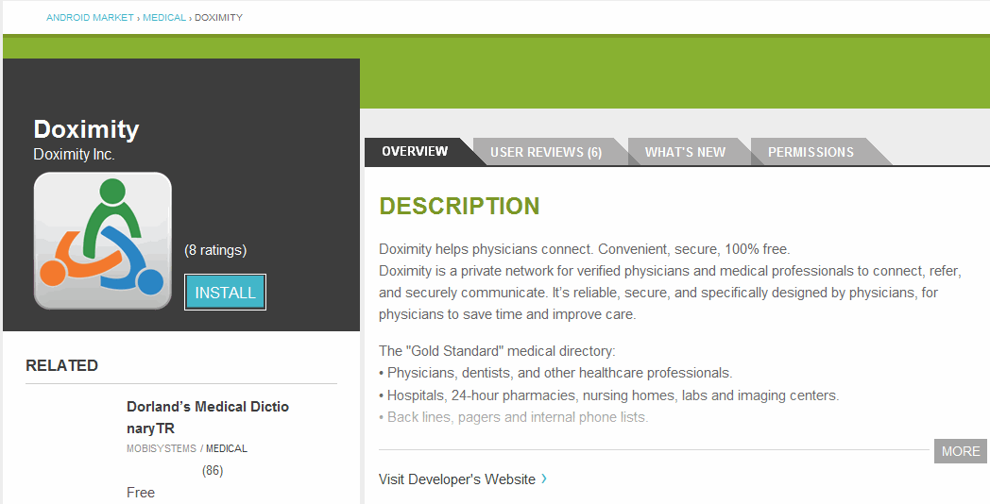
DoximityDroid up on Android Market
Notes:
=> DoximityDroid development team

Slide 43
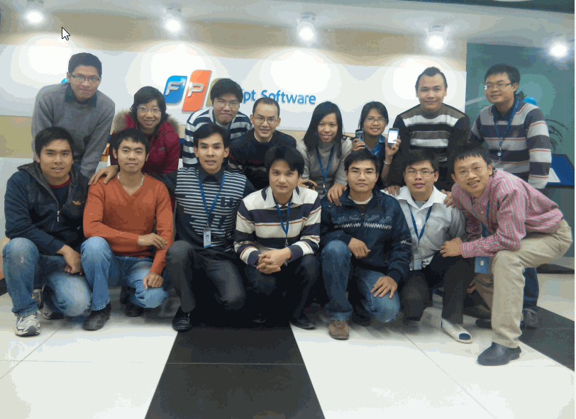
DoximityDroid Development Team
Notes:
=> Lesson Learnt and Practices

Slide 44
Thank you
for your attention

